Slide 1
Introduction of Integrated Publishing Toolkit, version 2 (IPT2)
Yu-Huang Wang
June 25, 2012

Slide 2
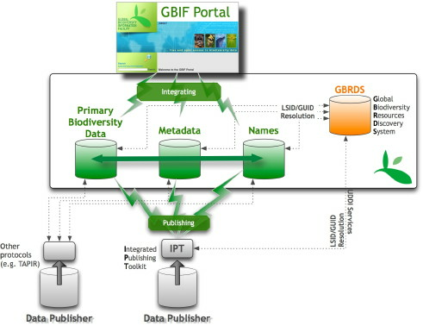
GBIF informatics infrastruture

Slide 3
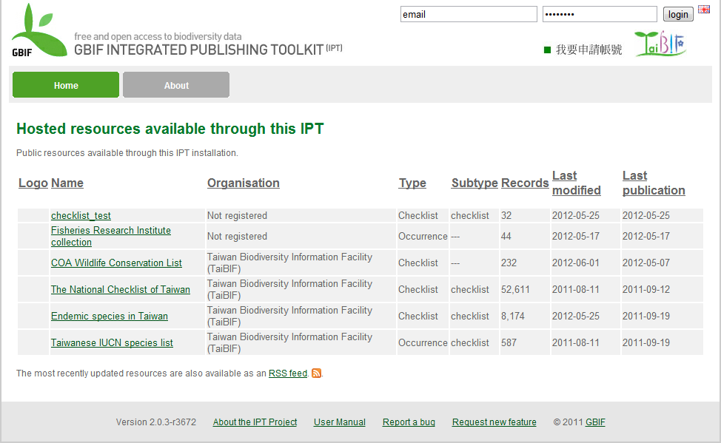
IPT2 for publish biodiversity data

Slide 4
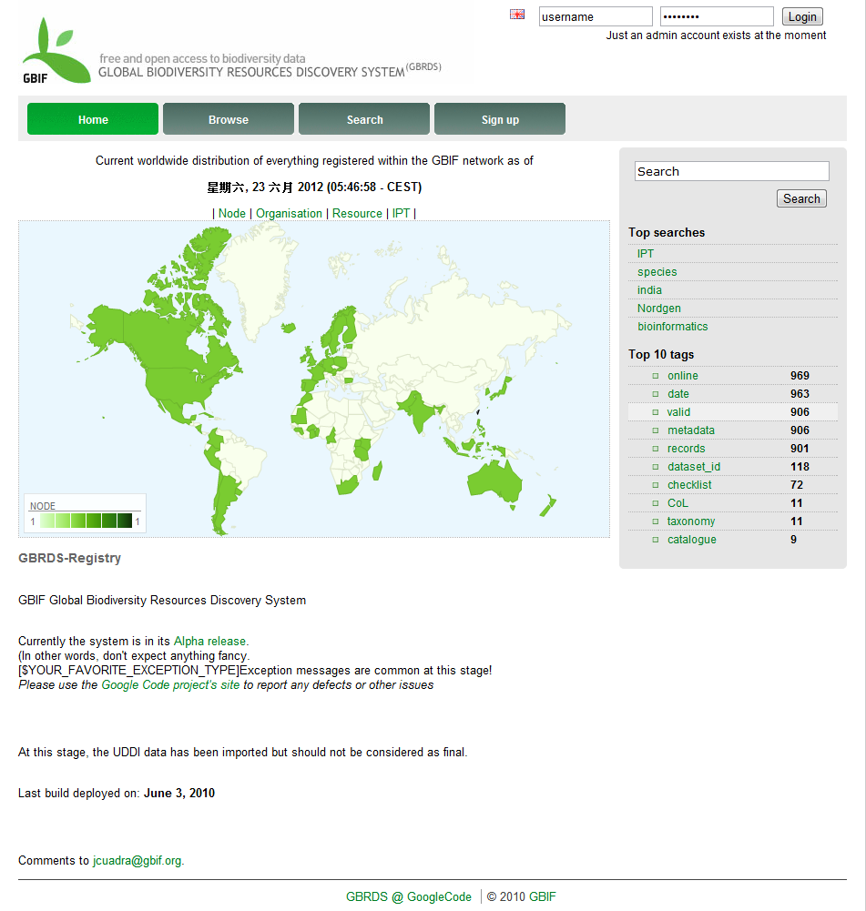
GBRDS for discovering and accessing biodiversity data
http://gbrds.gbif.org/index

Slide 5
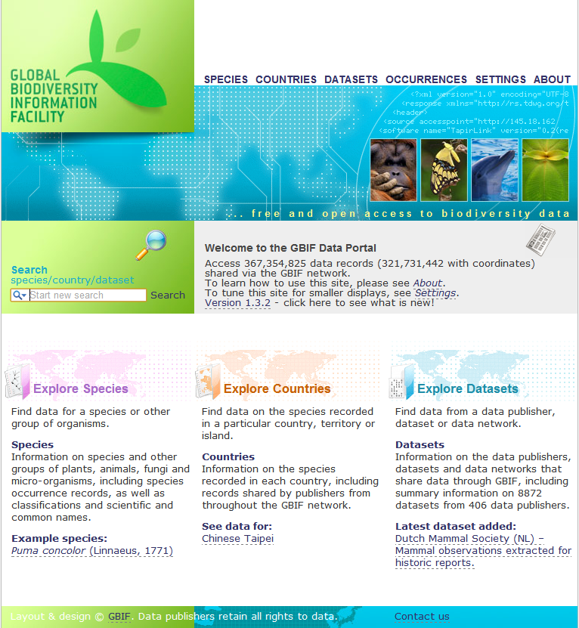
GBIF data portal
http://data.gbif.org

Slide 6
IPT2 user roles
User
Manager – without registration permission
Manager – with registration permission
Administrator

Slide 7
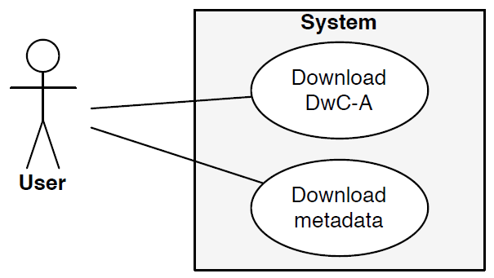
User use cases
View resources
Download metadata
Download DwC-A

Slide 8
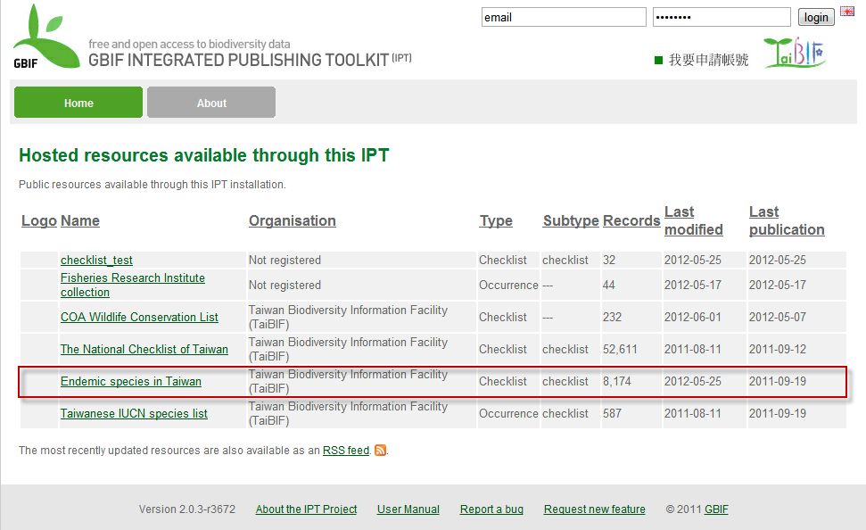
View resource

Slide 9
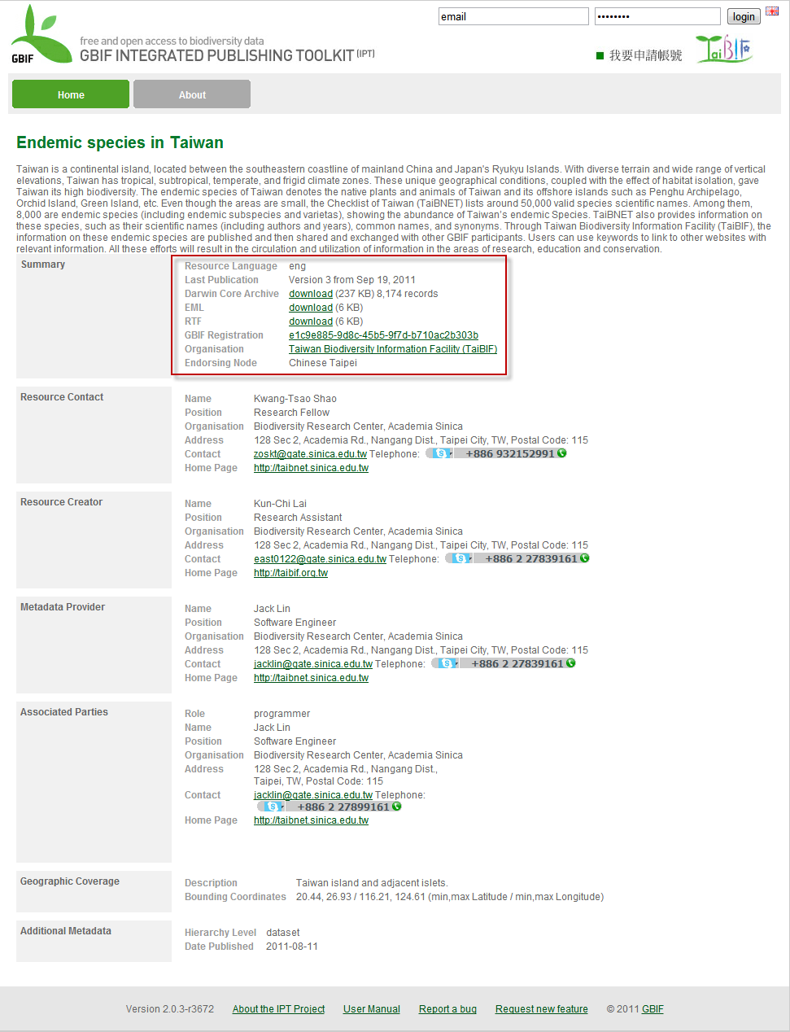
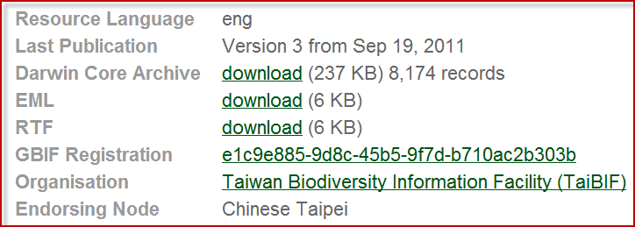
Download resource

Slide 10
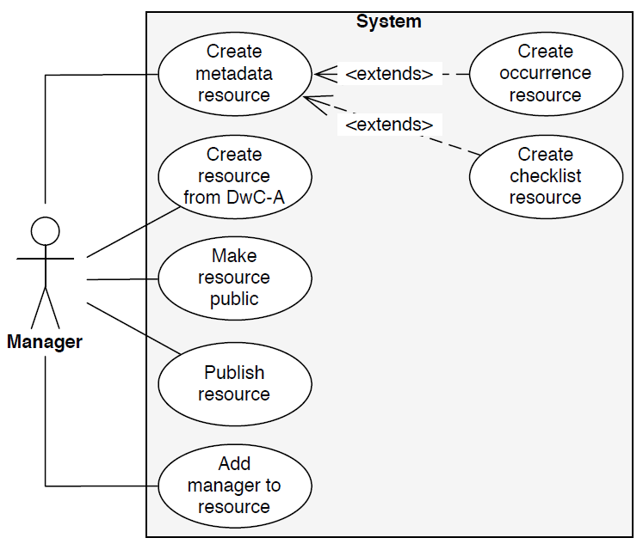
Managerial use cases
Create resource from DwC-A
Create metadata and resource - occurrence - check list
Make resource public
Publish resource
Add manager to resource
Register resource

Slide 11
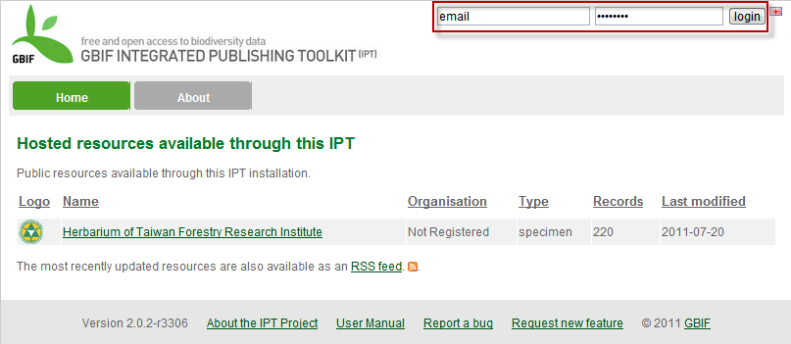
Login as manager

Slide 12
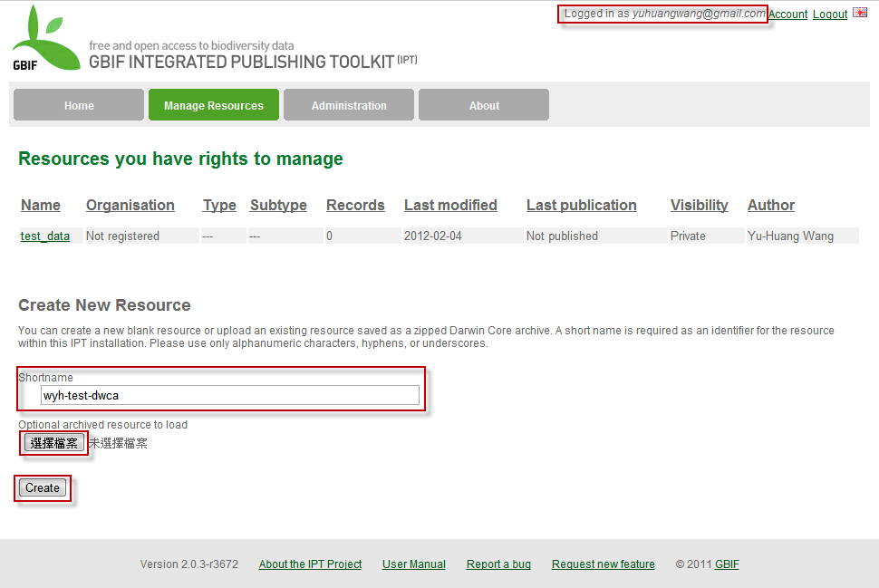
Create resource from DwC-A

Slide 13
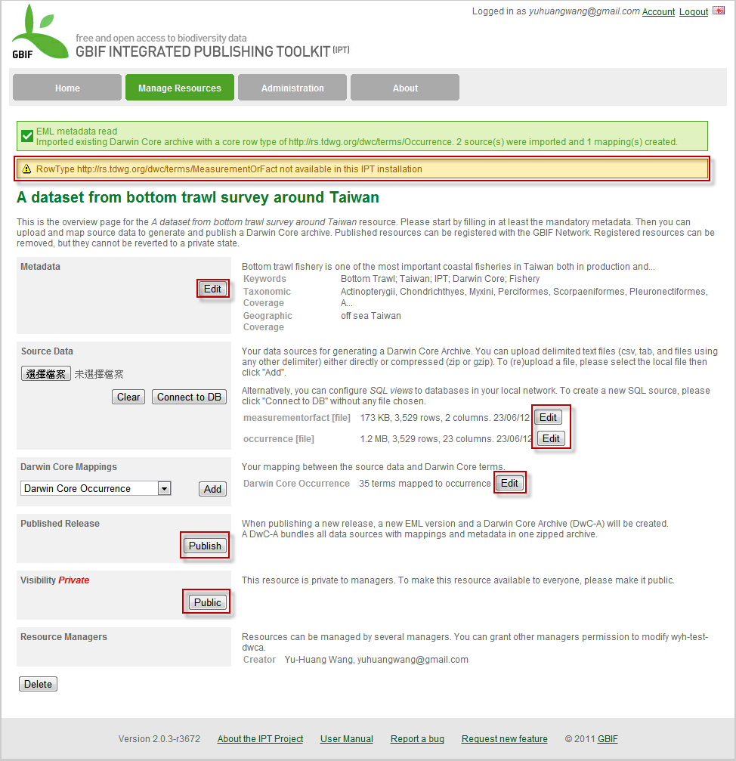
Create resource from DwC-A

Slide 14
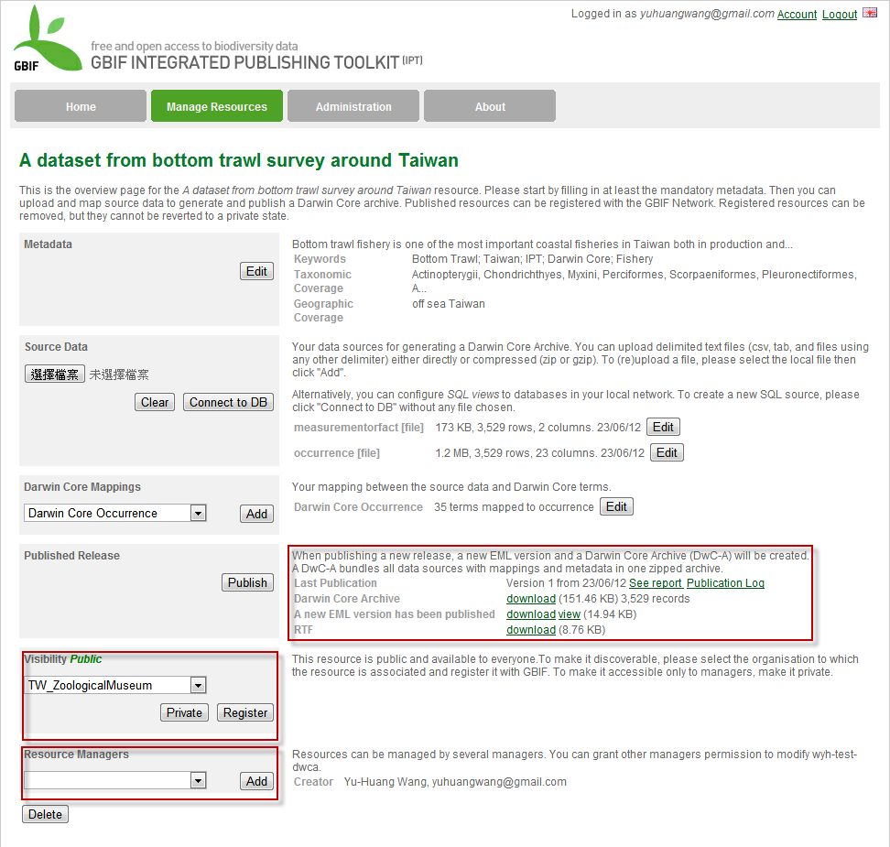
Create resource from DwC-A

Slide 15
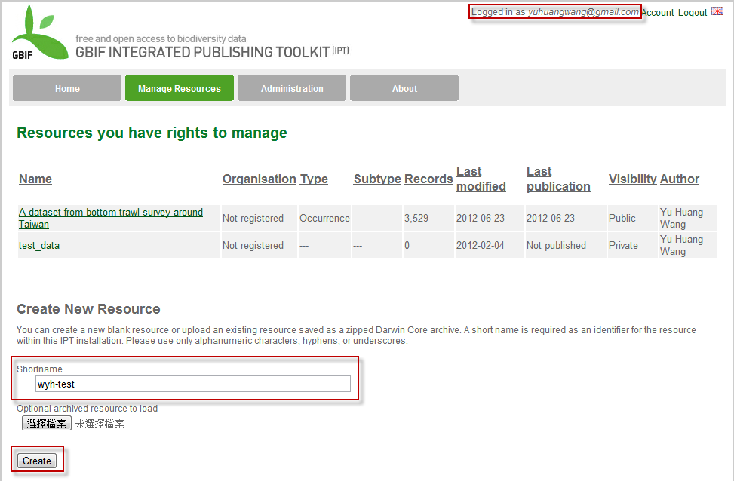
Create new resource

Slide 16
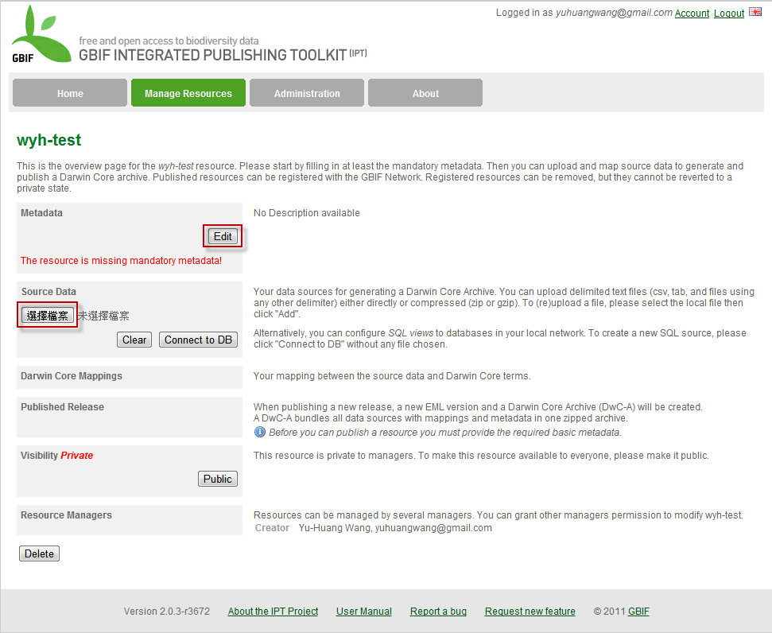
Create new resource

Slide 17
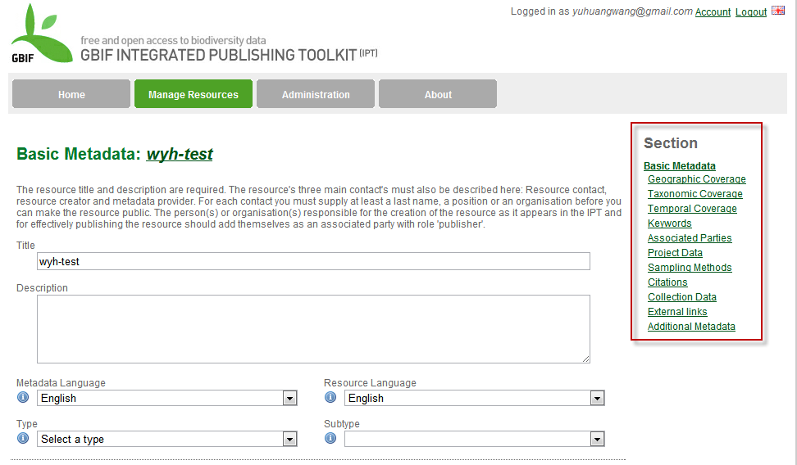
Create new resource - metadata

Slide 18
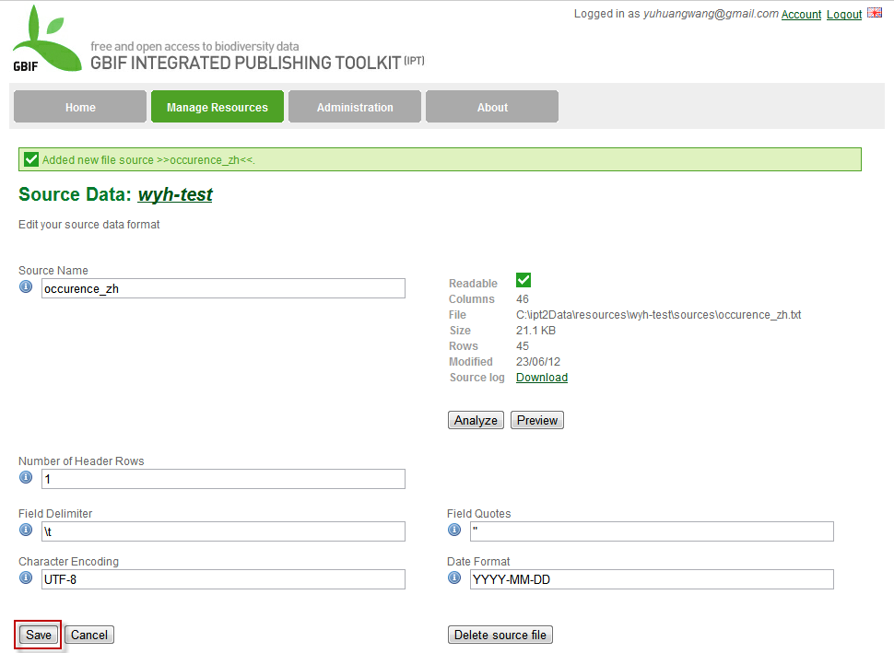
Create new resource – source data

Slide 19
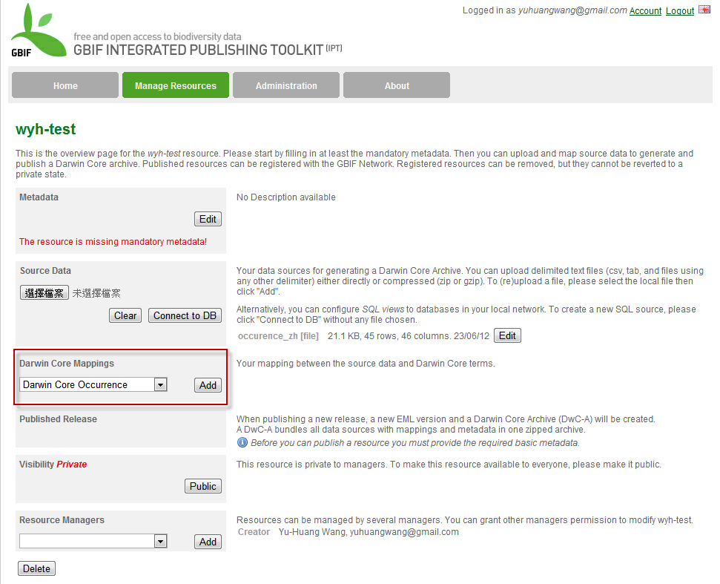
Create new resource – DwC mapping

Slide 20
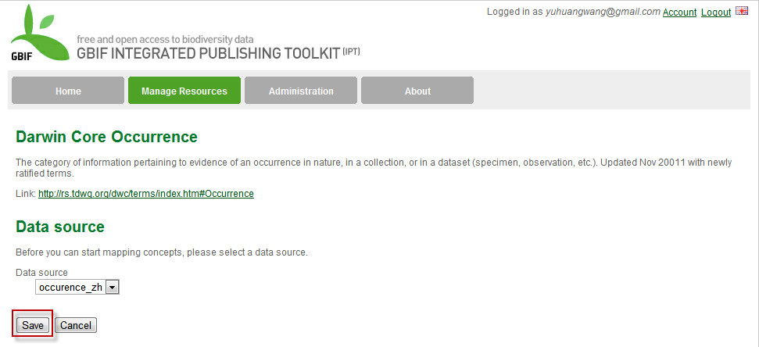
Create new resource – DwC mapping

Slide 21
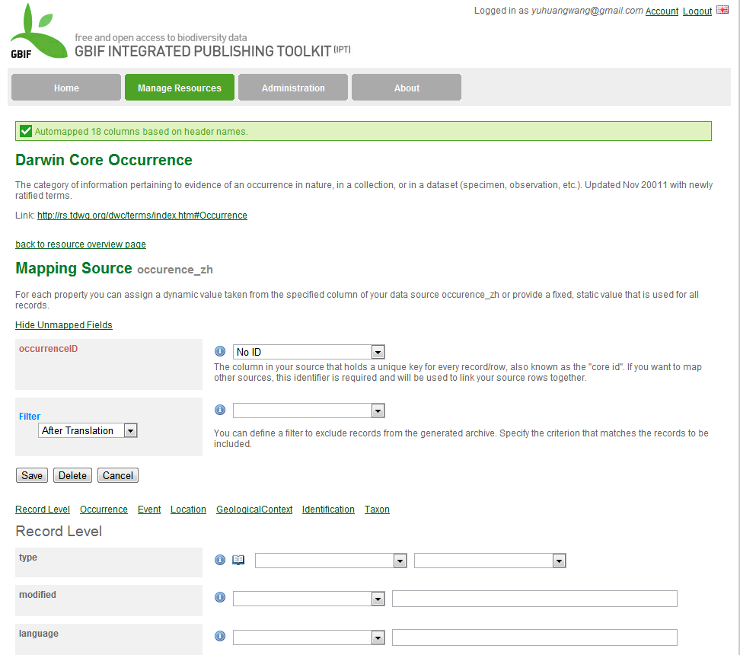
Create new resource – DwC mapping

Slide 22
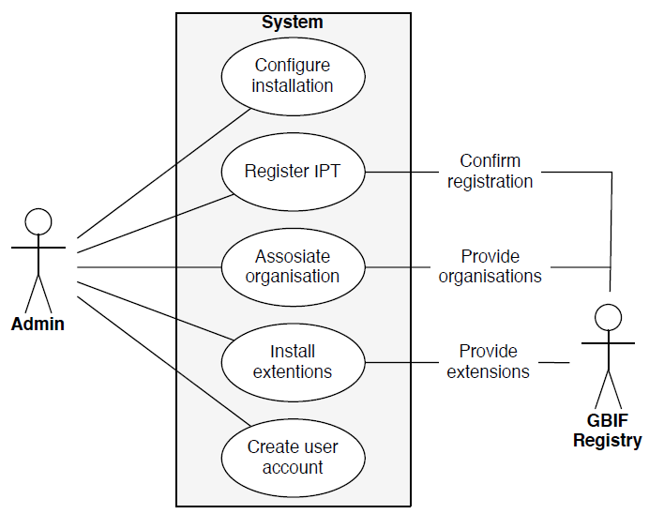
Administrative use cases
Configure installation
Create user account
Register IPT
Associate organization
Install extensions

Slide 23
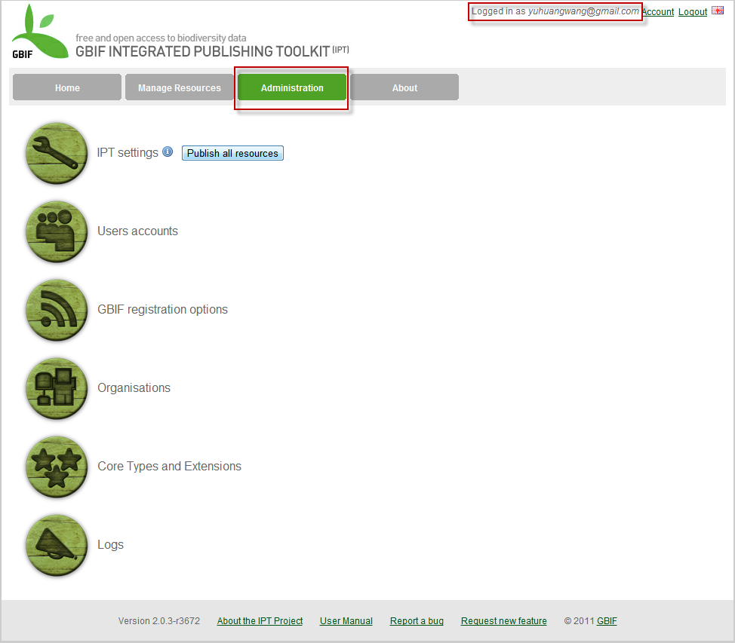
Login as administrator

Slide 24
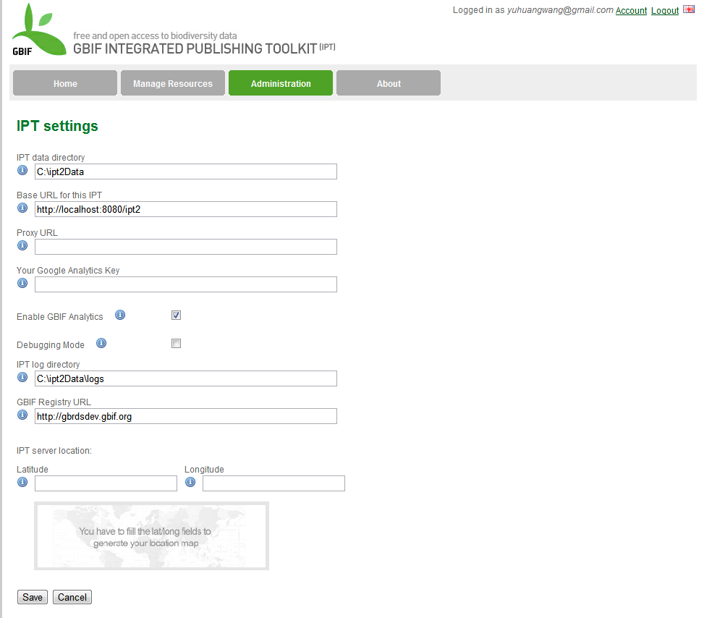
IPT setting

Slide 25
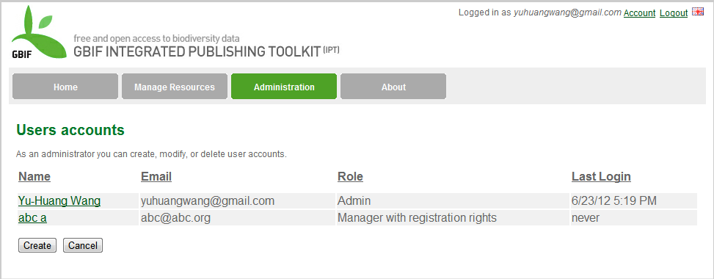
Create user account

Slide 26
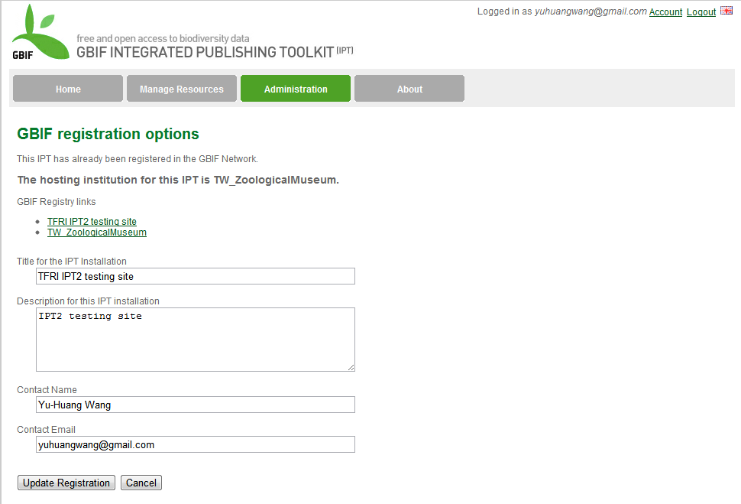
Register IPT

Slide 27
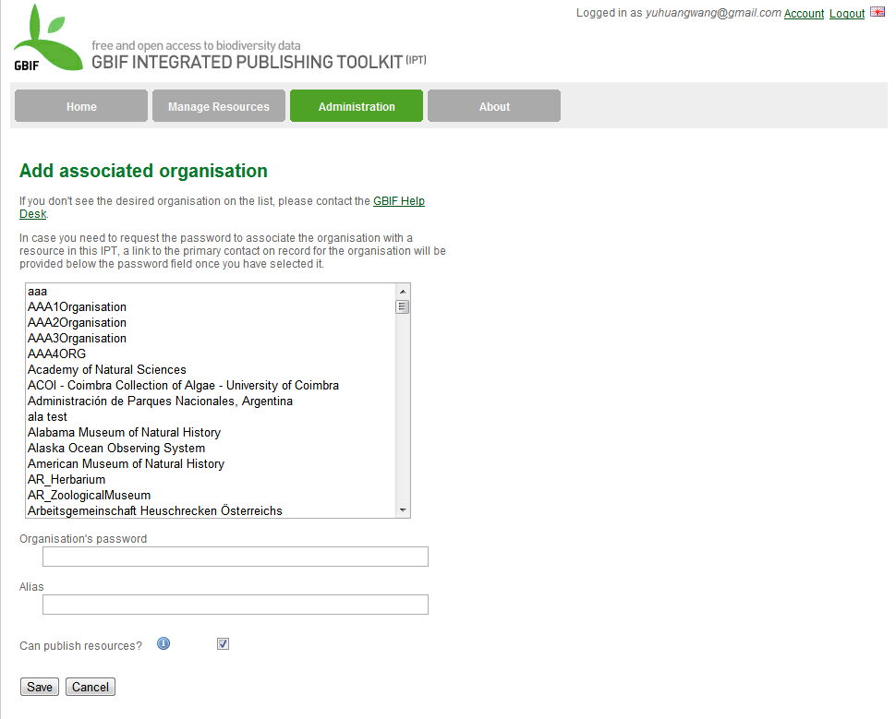
Associate organization

Slide 28
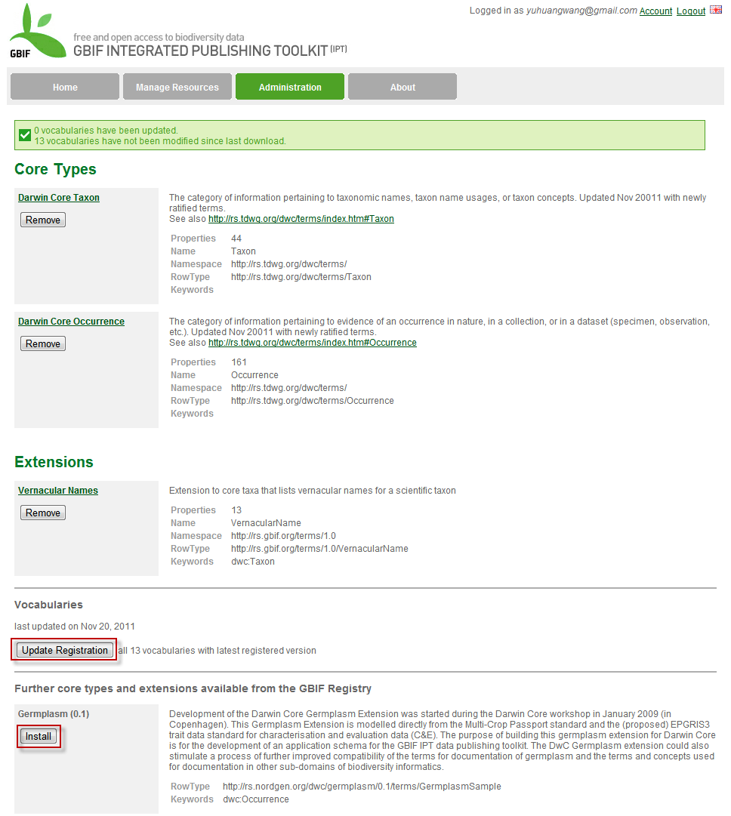
Install extensions

Slide 29
Reference
Integrated Publishing Toolkit (IPT) Architectural view http://code.google.com/p/gbif-providertoolkit/downloads/detail?name=ipt-architecture_1.1.pdf&can=2&q=
Integrated Publishing Toolkit User Manual http://code.google.com/p/gbif-providertoolkit/wiki/IPT2ManualNotes

Slide 30
Thank You!
http://taibif.tw

